Slide 1
Rates Continued

Slide 2
METRIC Units
What units of measurement (time, weight, length) do we use in Australia?
If you had to pick the common units we use, what would you choose?
There are Base and Common units. Base units are the standards used for metric units, often having a prefix added to increase of decrease their size. Common units are the ones we use for descriptions most often.
Weight:
Gram, Kilogram, Tonne
Length:
Millimetre, Centimetre, Metre, Kilometre
Time:
Seconds, Minutes, Hours, Days, Weeks, Fortnights, Months, Years, Decades, Centuries, Millenium.
So where do we get our metric units from?

Slide 3
https://www.youtube.com/watch?v=7bUVjJWA6Vw
Watch the video below to find out more about metric units.

Slide 4
So how do we compare rates?
Brainstorm ways in which you would need to compare rates and how you would do it?
BE PREPARED TO SHARE

Slide 5
Unitary Method
Imagine we go to the shop, and we want to buy Nutella.
Nutella comes in three sizes, 375g, 500g and 1kg.
The cost of each of these three items are
375g : $6.50
500g : $7.80
1kg : $13.90
So what’s the best buy for price per kilogram?

Slide 6
Lets compare:
375g : $6.50
500g : $7.80
1kg : $13.90
These prices all vary according to weight, so which is the best option to buy?
If we divide the price of each jar, by the same weight unit- in this case we will use kg to find the cost of $/kg
Convert the weights to the same units [We will use Kilograms, so 375g -> 0.375kg, 500g -> 0.5kg]
Then divide the prices by the weight in Kilograms
6.50 / 0.375 = $17.33 per/kg
7.80 / 0.500 = $15.60 per/kg
13.90 / 1.00 = $13.90 per/kg

Slide 7
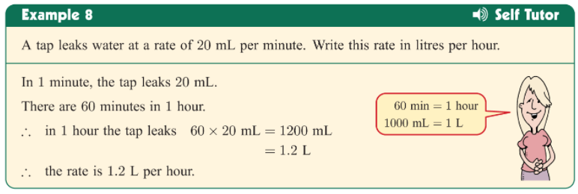
Practise: Convert these rates to standard forms
The price per kg, if it cost $7.50 for 50g
The km per hour if it takes 15 minutes to do 20km.
The BPM, if the heart beats 24 times in 20 seconds
The cost per meter if it is $3.75 for 30cm.

Slide 8
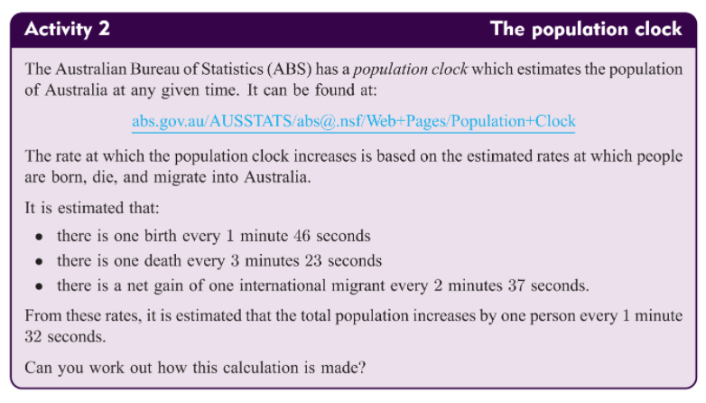
Lets find rates in real life
Use your knowledge of rates to go to this website and see the estimated rates of births and deaths in Australia
http://www.abs.gov.au/ausstats/abs@.nsf/94713ad445ff1425ca25682000192af2/1647509ef7e25faaca2568a900154b63!OpenDocument

